Slide 1
How To Stop Smoking
Fiona McGlue
Aisling Pearson
Copyright © Cancer Focus Northern Ireland 2015 All rights reserved

Slide 2
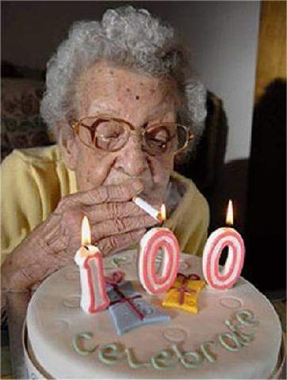
Every Smokers Fantasy
Copyright © Cancer Focus Northern Ireland 2015 All rights reserved

Slide 3
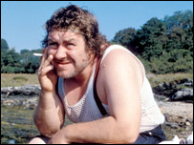
1. Do Not Smoke
Don’t start smoking
Try to stop smoking
Be aware of passive smoking
Make your home smoke free
Copyright © Cancer Focus Northern Ireland 2015 All rights reserved

Slide 4

Take a Guess???
What percentage of people in NI smoke?
Copyright © Cancer Focus Northern Ireland 2015 All rights reserved

Slide 5
Correct Answer
22%
That’s less than ¼
Copyright © Cancer Focus Northern Ireland 2015 All rights reserved

Slide 6
1000 children become long-term smokers
How many are murdered?
1
How many die from road accidents?
6
How many die from smoking?
500
Copyright © Cancer Focus Northern Ireland 2015 All rights reserved

Slide 7
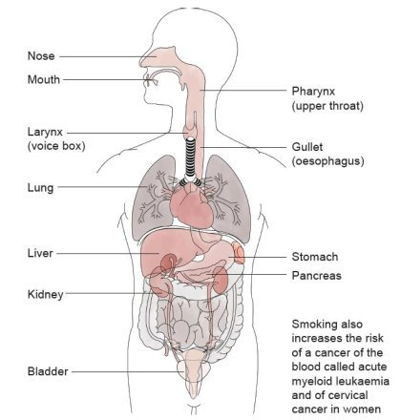
Cancers caused by smoking
Copyright © Cancer Focus Northern Ireland 2015 All rights reserved

Slide 8
The Smoking Habit
3 aspects of smoking:
Physical addiction to the drug nicotine
Automatic habit - ritual of handling, opening the pack, lighting up, etc.
Psychological/Emotional dependence – coping with stress, boredom, anxiety, low mood, etc.
Copyright © Cancer Focus Northern Ireland 2015 All rights reserved

Slide 9
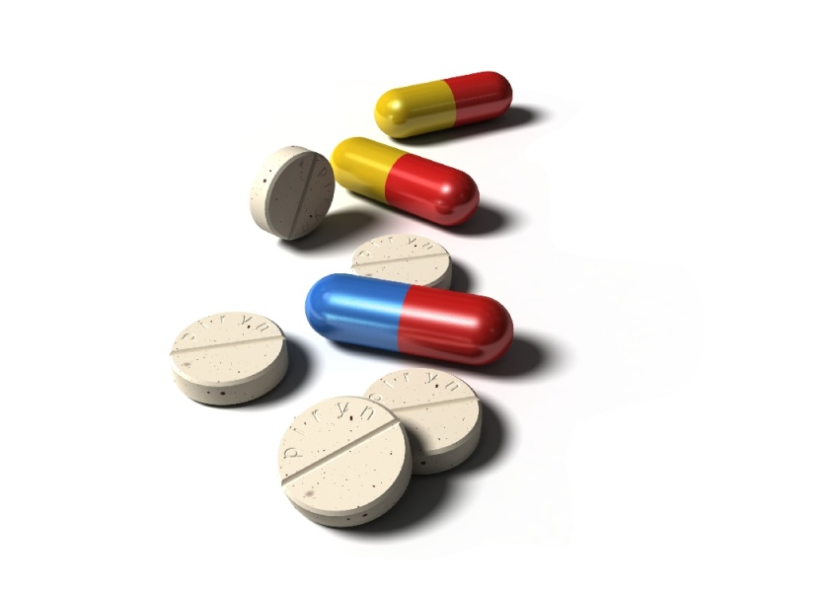
Addiction
Nicotine is equally as addictive as:
    = Heroin
    = Cocaine
    + Alcohol
    + Caffeine
Copyright © Cancer Focus Northern Ireland 2015 All rights reserved

Slide 10
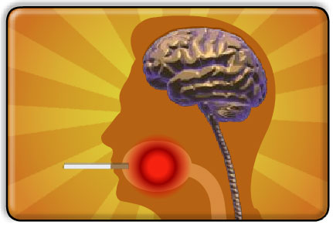
Nicotine
▼
Blood
▼
Brain
▼
Dopamine
(feel good chemical)
▼
Satisfaction / pleasure
Copyright © Cancer Focus Northern Ireland 2015 All rights reserved

Slide 11
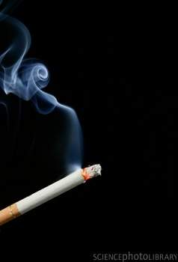
So What Is The Problem with Smoking?
Benzene
Ammonia
Formaldehyde
Tar
Carbon monoxide
Hydrogen cyanide
Arsenic
Over 50 carcinogenic toxins¹
1. Hoffmann D & Hoffmann I. J Toxicol Environ Health 1997; 50(4):307-364.
www.treatobacco.net./English/keyfindings/key_finding_1.html Last accessed on 15.02.08
Copyright © Cancer Focus Northern Ireland 2015 All rights reserved

Slide 12



Carbon Monoxide
Prevents body getting oxygen
Muscles – everyday activity
Brain – concentration
Skin – dull appearance
Copyright © Cancer Focus Northern Ireland 2015 All rights reserved

Slide 13
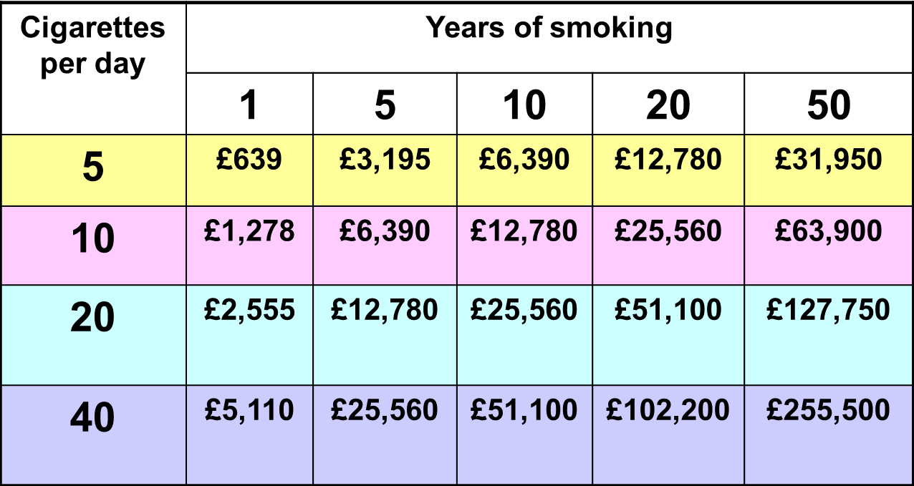
The cost of smoking
(based on £7 per pack of 20)
Copyright © Cancer Focus Northern Ireland 2015 All rights reserved

Slide 14
The cost of smoking
(based on £8 per pack of 20)
Cigarettes per day | Years of smoking
 | 1 | 5 | 10 | 20 | 50
5 | £730 | £3,650 | £7,300 | £14,600 | £36,500
10 | £1,460 | £7,300 | £14,600 | £29,200 | £73,000
20 | £2,920 | £14,600 | £29,200 | £58,400 | £146,000
40 | £5,840 | £29,200 | £58,400 | £116,800 | £292,000
Copyright © Cancer Focus Northern Ireland 2015 All rights reserved
Notes:
14

Slide 15


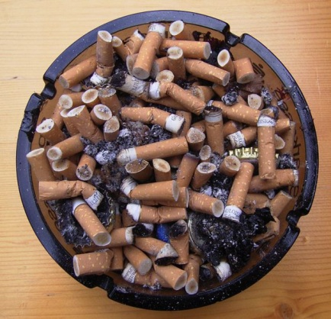
The cost for you
10 a day
12 weeks = £336.00
840 cigarette butts OR
Copyright © Cancer Focus Northern Ireland 2015 All rights reserved

Slide 16

The cost for you
20 a day
1 year = £2,920
7,300 cigarette butts OR
Copyright © Cancer Focus Northern Ireland 2015 All rights reserved

Slide 17
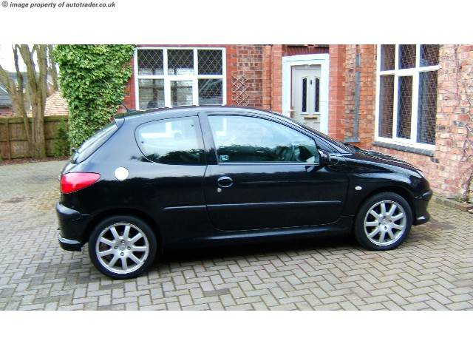

www.autotrader.co.uk £1,995
Copyright © Cancer Focus Northern Ireland 2015 All rights reserved

Slide 18
Health Benefits of Stopping Smoking
20 minutes Blood pressure and pulse - normal
24 hours Carbon monoxide eliminated
48 hours Nicotine is eliminated
3-9 months Coughs & wheezing improve
1 year Risk heart attack is halved
10 years Risk lung cancer falls to half that of a smoker
Copyright © Cancer Focus Northern Ireland 2015 All rights reserved

Slide 19
What about YOU?
Do you really want to stop smoking?
If so, why are you still smoking?
  You must want to stop to succeed in stopping.
Stress
Withdrawal symptoms
  Lack of will power
  Weight gain
Copyright © Cancer Focus Northern Ireland 2015 All rights reserved

Slide 20
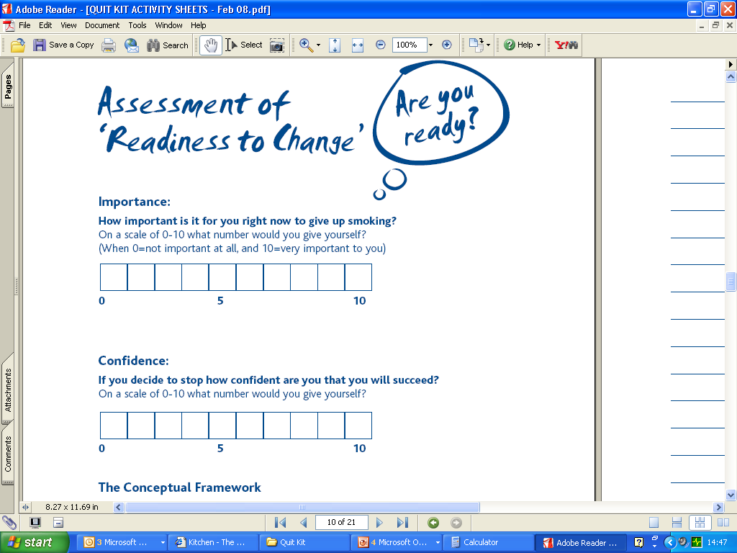
Copyright © Cancer Focus Northern Ireland 2015 All rights reserved

Slide 21
Stop Smoking Support Service
One to One tailored treatment plan
Pharmacy
GP Practice
Community based clinic
Copyright © Cancer Focus Northern Ireland 2015 All rights reserved

Slide 22
Stop Smoking Aids - Pharmacological
Nicotine Replacement Therapy
  Patches
  Gum
  Inhalator
  Nasal spray
  Microtab
  Lozenge
  Mouth spray
  Strips
Zyban
Champix
Copyright © Cancer Focus Northern Ireland 2015 All rights reserved

Slide 23
Be successful with a Service
NRT/pharmacotherapy
= 2x success
NRT/pharmacotherapy + support
= 4x success
Copyright © Cancer Focus Northern Ireland 2015 All rights reserved

Slide 24
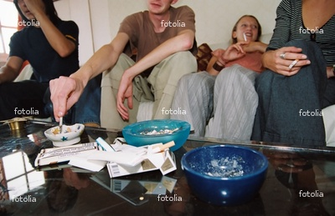
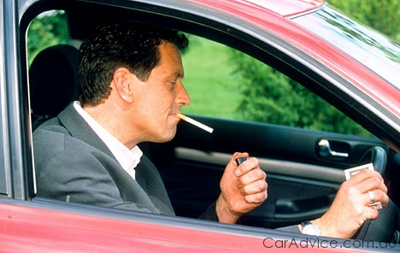
Making changes…
Make your
home smoke-free
Make your
car smoke-free
Copyright © Cancer Focus Northern Ireland 2015 All rights reserved

Slide 25
Succeeding in Stopping
Change your habits so smoking is no longer the easy option
Be prepared for situations that may be difficult for you
Use aids to help you stop smoking
Take one day at a time
Treat yourself
Copyright © Cancer Focus Northern Ireland 2015 All rights reserved

Slide 26

N.I. info www.want2stop.info
Copyright © Cancer Focus Northern Ireland 2015 All rights reserved

